Slide 1


Converting to Agile:
You want me to do what? But Why?!

Slide 2

A Little About Me
Manager of Solutions Delivery, BA & Scrum Master with Leading EDJE in Columbus, Ohio
Java Developer for 9 years in multiple industries
Passionate about Agile
Got my PMI-ACP in December of 2014
Got my PSM 1 in March 2016
Experience as a Scrum Master, BA, and Agile Coach

Slide 3
Itinerary
What is Agile?
Agile Manifesto
Scrum Basics
Answering specific questions
Answering YOUR Questions

Slide 4

Notes:
Presentation is all about Questions.
Think about questions you came here hoping to get answered.
There will be time at the end to answer questions I don’t hit in the presentation

Slide 5
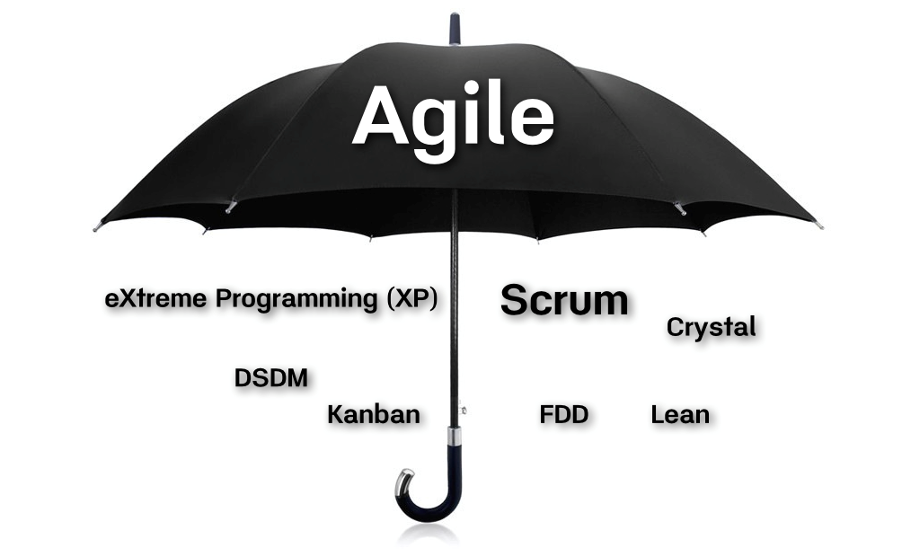


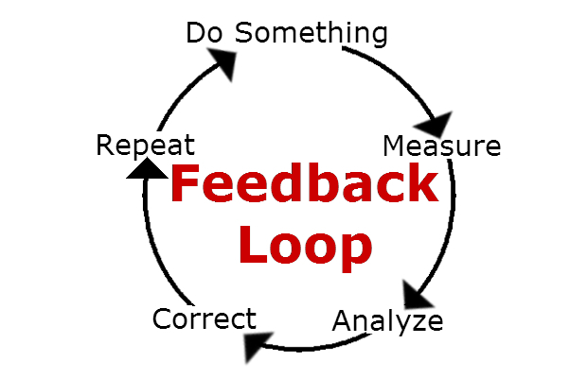
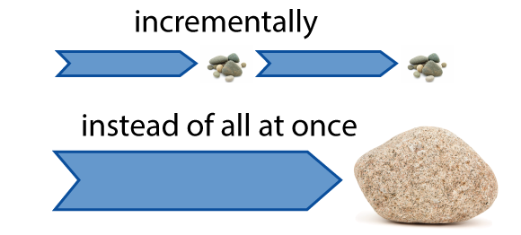
What is Agile?
Notes:
Single Methodology with multiple defined practices
Set of principles we follow every day
Manifesto/Mission Statement that we believe in and follow
Incremental process – smaller parts
Feedback loops

Slide 6
Agile Manifesto
Individuals and interactions over processes and tools
Working software over comprehensive documentation
Customer collaboration over contract negotiation
Responding to change over following a plan
That is, while there is value in the items on
the right, we value the items on the left MORE.

Slide 7
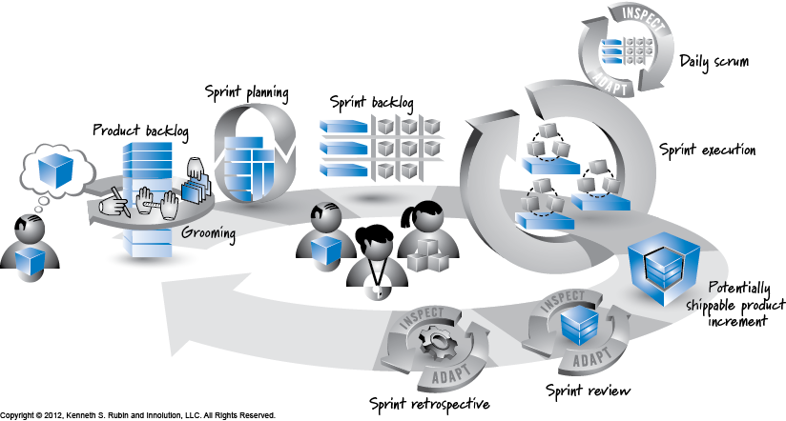
Scrum Basics
Notes:
Create and prune a Product Backlog
Hold Sprint Planning Meetings every iteration
Create a Sprint Backlog from the Sprint Planning Meeting
Hold Daily Scrums – What did yesterday; What doing today; Any Impediments
Implement stories during Sprint Iteration (2 – 4 weeks)
Create Potentially Shippable product at end of Sprint
Sprint Review with all Stake holders (Feedback loop!)
Sprint Retrospective with Sprint Team – What did we do good? What could be improved?
Start over again!

Slide 8
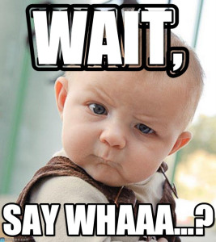
Why are we being asked to produce code every 2 weeks?
Developers:
Notes:
Iterative development is important for many reasons.
Get product in front of users quicker
Get feedback from users in a faster manner
Able to adapt to change before too far set in one path
Feeling of accomplishment – bite sized pieces

Slide 9
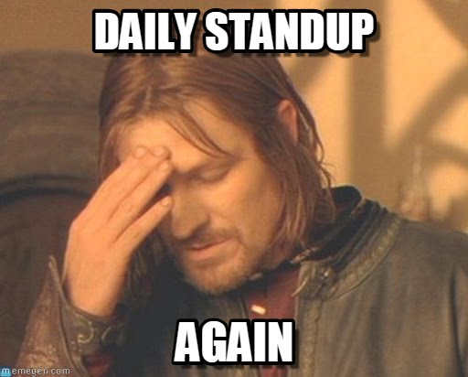
Notes:
How many of your teams feel like this? And then you get this question: (NEXT SLIDE)

Slide 10
Why do we have to have a 15 minute stand-up meeting every morning?
Notes:
Daily Standups are NOT a requirement of Agile. They are a requirement of SCRUM.
If you are implementing Scrum, the Daily Standup is the point where we get the following questions asked:
What did you do yesterday? What doing today? Any impediments
This is important for multiple reasons.
Transparency. Scrum teams are supposed to be Self-Organizing. Therefore, they have to communicate and know what is going on with the team.
Commitment. When a team member says they will work on X today, the rest of the team knows they will get an update on X tomorrow
Collaboration. If there are impediments, the Scrum Master can help, or a team member with knowledge can help after the standup

Slide 11
Why is it called a “Stand-Up”? Why is it important that we physically stand up?
Notes:
Daily Standups are NOT a requirement of Agile. They are a requirement of SCRUM.
If you are implementing Scrum, the Daily Standup is the point where we get the following questions asked:
What did you do yesterday? What doing today? Any impediments
This is important for multiple reasons.
Transparency. Scrum teams are supposed to be Self-Organizing. Therefore, they have to communicate and know what is going on with the team.
Commitment. When a team member says they will work on X today, the rest of the team knows they will get an update on X tomorrow
Collaboration. If there are impediments, the Scrum Master can help, or a team member with knowledge can help after the standup

Slide 12

What is a Retrospective?
And why do we need to have one?
Notes:
Ahhh yes, the dreaded Retrospective.
Retrospectives are yet another SCRUM meeting. The goal of the retrospective is to get feedback from the team.
What did we do well? What could we improve? Any ideas?
The trick to a productive retrospective is having a process in place for acting on the feedback. Too often, teams have the retrospective, but nothing is done to resolve what was said last time. Have a plan in place!!
You get the “uhhh….I dunno” or the “I don’t care” attitudes because nothing is done.

Slide 13
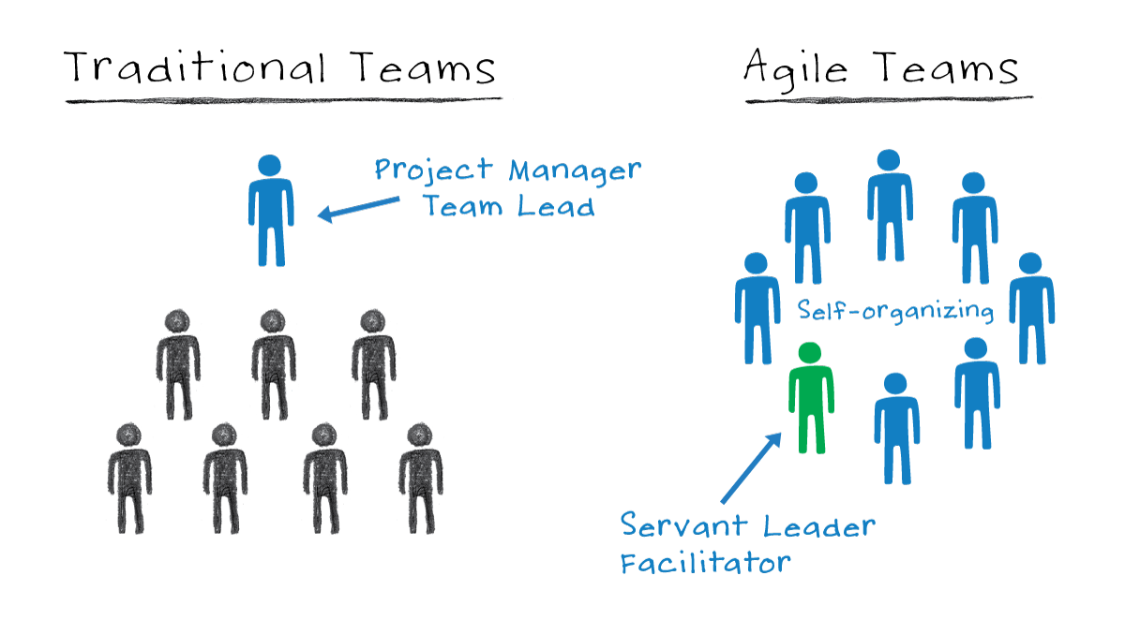
What the heck is a ‘Self-Organizing’ team and why is it important?
Notes:
Self-Organizing teams does not mean that the team gets to choose what the scope is. Does not (always) mean you get to choose who you work with
What it DOES mean:
Team determines the commitment for the iteration
Team determines the work each member will do
Work is NOT assigned to specific members

Slide 14
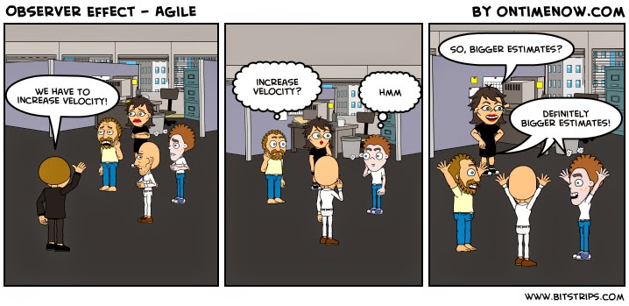
What is velocity and why do I care?

Slide 15
How do I know when something is Done?
Notes:
Definition of Done

Slide 16

What do you mean the requirements changed?!?
Notes:
Do you or your team ever feel like this when hearing that the requirements have changed? (click)
Change is integral in the Agile Methodology. The trick is minimizing the severity of the change.
Do your homework up front, and deliver and demo to your clients often, and hopefully the impact of the change will be minimalized
Feedback is what we want!

Slide 17
When do requirement changes get implemented/added to scope?

Slide 18

What Questions have YOU been asked?
Notes:
If you don’t have questions…I will ask some questions for you!

Slide 19
Thank You!
Heather Tooill
Leading EDJE
Heather.Tooill@leadingedje.com
@HeatherTooill
http://speakerrate.com/speakers/133371-htooill

